Slide 1
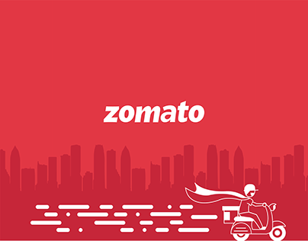
ZOMATO
(Discover Great Places to Eat)
SUBMITTED BY :- YATIK SHAKYA
(14th August, 2024)

Slide 2

ABOUT ZOMATO
Zomato was founded by Deepinder Goyal and Pankaj Chaddah in 2008.
Zomato is an Indian multinational restaurant aggregator and food delivery company.
Zomato provides information, menus and user-reviews of restaurants as well as food delivery options from partner restaurants in more than 1,000 Indian cities and towns, as of 2022–23.
Zomato, originally known as “Foodiebay,” was started as a simple online restaurant directory soon transformed into a comprehensive food.

Slide 3

PROJECT AIM
Financial Objective: To increase their fund and revenue.
Marketing Objective: To tap their customers from across the glob.
Growth Objective: To grow continuously and increase their customers and page traffic.
Globalization Objective: To expand themselves across the whole globe as a leading service provider.

Slide 4
PROBLEM STATEMENT
Despite Zomato's vast user base and global presence, there exists a significant gap in the market for high-quality, Zomato-branded restaurants that offer a consistent and exceptional dining experience across different countries. Current challenges include :
1. Inconsistent dining experiences across locations
2. Limited brand visibility and recognition in new markets
3. Difficulty in maintaining quality control and standards across multiple locations
4. Inefficient use of Zomato's vast user data and insights for restaurant development

Slide 5
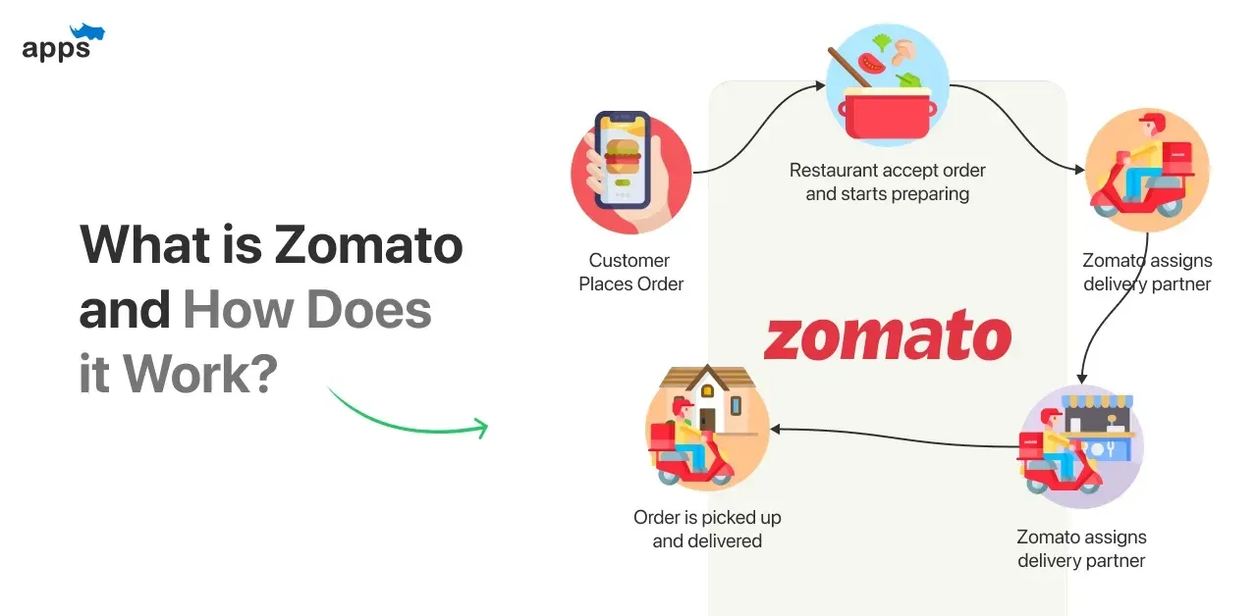
HOW ZOMATO WORKS?
Step 1:Users can explore various restaurants and order meals from the desiccated app solution or website.
Step 2:Particular restaurant owners receive an order request and start preparing a meal.
Step 3:Once the food is ready to dispatch, it will be handed over to delivery providers.
Step 4:Delivery providers deliver the meal to the customer’s preferred location.
Step 5:Customers can make payments and share reviews based on their experience with the given payment options.

Slide 6
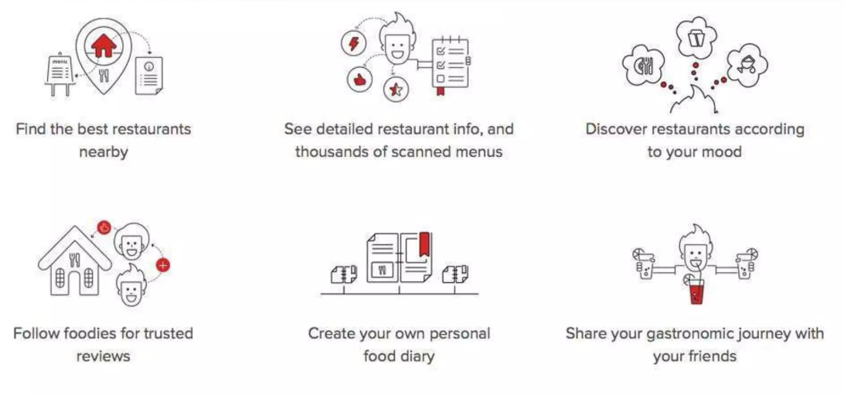
ZOMATO’S HELP!

Slide 7

Zomato
Market analysis
Data
snapshot
Total number of restaurant: 9551 restaurants with different types of cuisines which is categories as north Indian, Chinese, Bakery and tea etc.
Opening year of restaurant: maximum number of restaurant opened in year 2011 whereas minimum number of restaurant opened in year 2012.
Geographical coverage: Zomato restaurants services reaches 15 countries all over the world, showing worldwide penetration.
Data cleaning and preprocessing:
Removing null values in longitudes & latitudes and replace with their averages.
Fill blank spaces of cuisine columns to enhance the data integrity.
Addressed new column to know about cost in Indian currency to enhance data integrity.
Create new column to know about restaurants opening year for perfect data analyzing.
This data allow for in-depth analysis about Zomato restaurant and its rating.

Slide 8

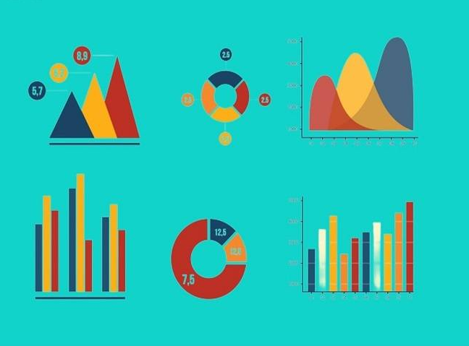
ANALYTICAL APPROACH AND TOOLS
Data Cleaning: Using function like FIND AND REPLACE, CLEAN, TRIM to ensure data accuracy.
Data Enrichment: enhance the dataset with additional variables using VLOOKUP to cross-reference external data sources.
Descriptive Analysis: Employed pivot tables for summarizing key metrics and identifying restaurant opening & rating pattern.
Visualization: Create dynamic charts and dashboards for data representation.

Slide 9
ANALYSIS
INFORMATION:
INDIA HAS HIGHEST NUMBERS OF RESTAURANTS AND UNITED STATES OF AMERICA IS SECOND HIGHEST IN THIS LIST.
LEAST NUMBER OF RESTAURANT FINDS IN CANADA I.E. ONLY 4.
FINDING:
WE FIND THIS INFORMATION EASILY THROUGH PIVOT TABLE AND ITS COLOUMN CHART.
THIS HELP IN ANALYSING RESTAURANTS ACROSS THE 15 COUNTRIES.
KEY INFORMATION:
KEY INFORMATION IS THAT NOW WE KNOW THAT WHERE WE HAVE TO OPEN THE NEW RESTAURANTS.

Slide 10
GROWTH IN MARKET
Highest number of restaurants open was opened in 2018.
After 2011 we can se a drop in next year(2012).

Slide 11
COUNTRIES DEMANDED ON BASIS OF VOTES
Indonesia is having the highest number of voters in restaurants, followed by UAE, USA and Philippines.
As compare to number of restaurants in India, the number of voters are very less.

Slide 12
ANALYSIS OF RESTAURANTS HAVE ONLINE DELIVERY
NO. OF RESTAURANT HAS ONLINE DELIVERY :-
28% OF RESTAURANTS HAVE GIVEN ONLINE DELIVERY.
152% OF RESTAURANTS HAVE GIVEN ONLINE DELIVERY.

Slide 13
TABLE BOOKING
NO. OF COUNTRY HAS TABLE BOOKING :-
20% OF BOOKING IN QATAR.
20% OF BOOKING IN SINGAPORE.
60% OF BOOKING IN UNITED ARAB EMIRATES.
80% OF BOOKING IN UNITED KINGDOM.

Slide 14
ANALYSIS OF CUISINES
First We Create Pivot Table
Then We Select Top 10 Cuisines By Value Filter.
Then We Create Column Chart To Show The Data.
North Indian cuisines are on top of the table on the basis of average cost of two in Indian rupees.

Slide 15
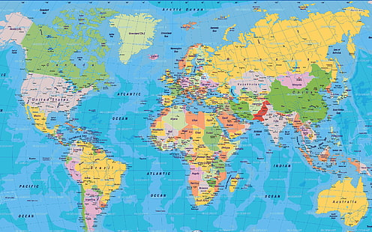
COUNTRIES WHICH ARE SUITABLE TO OPEN NEW RESTAURANTS
CANADA - based on the number of restaurants were already presents there were 4 and having average ratings of more than 3.5
QATAR - based on the number of restaurants were already presents there 20, having average ratings of more than 4 and have more than 163 of average voters.
UNITED STATES OF AMERICA - based on the number of restaurants were already presents there were 434 but having average ratings of more than 4, and have more than 428 of average voters and also has online delivery available.

Slide 16
DISTRIBUTION OF NUMBER OF RESTAURANTS AMONG DIFFERENT PRICE IN ALL COUNTRIES
Different countries have different number of restaurants within the different price range. Whereas India have the maximum number of the of the restaurants among all price ranges.
States such as the United States, United Kingdom, and South Africa have a more balanced distribution across the different price ranges but with significantly lower totals compared to India.
Countries like Indonesia, Sri Lanka, and Qatar, have minimum number of restaurants.

Slide 17
Expenditure in different countries based on India currency
Expenditure is higher in Singapore crossing the mark of Rs.12000
Philippines is the second country which has second higher expenditure.
Turkey is the country which has the lowest expenditure among all the countries having value below than Rs.2000

Slide 18
Recommendation For Opening New Restaurants
United Arab Emirates
Sharjah - Near New City Center Supermarket, Abu Shagara, Sharjah
Qatar
Doha - 1st Floor, The St. Regis Hotel, Westbay, Doha
Singapore
Singapore - 803 Raffles Avenue, #01-15 Esplanade Mall 039802
United Kingdom
Birmingham - 1 Canal Square, Brindleyplace, Birmingham B16 8EH

Slide 19
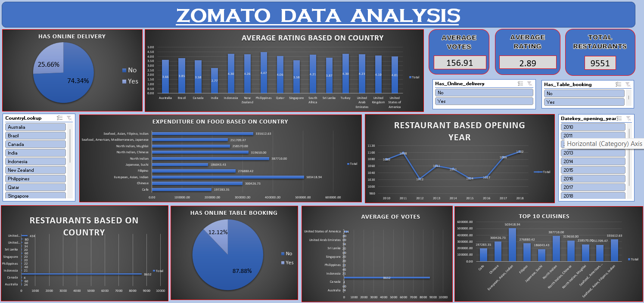
DASHBOARD

Slide 20
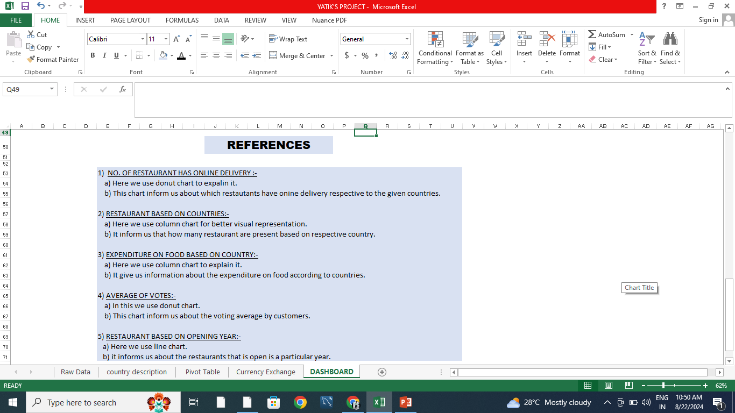
REFERENCES

Slide 21

CONCLUSION
In conclusion, our analysis of Zomato Restaurants data reveals promising opportunities for strategic expansion across the globe. By targeting regions with high demand, catering to specific demographic preferences, and capitalizing on competitive advantages, we can confidently recommend the opening of new restaurants. This initiative not only enhances market presence but also delivers exceptional dining experiences, driving sustainable growth for Zomato and enriching the global culinary landscape.

Slide 22
RECOMMENDATIONS
Zomato should capitalize on its multi-cuisine approach to cater to diverse tastes, enhancing its appeal to a broader customer base.
Canada, Qatar and united states of America are some of the most unclustered markets for Zomato that may offer new opportunities for market penetration.
Customers are also ready to spend more money according to there need.
Online delivery and table booking generally exceed into a higher rating.
This approach to cuisine selection ensures that investments are tailored to the financial capacities and strategic goals of the stakeholders, maximizing the potential for success in the chosen markets.

Slide 23
THANKYOU

